Slide 1
Mechanics Design
Smart -Convenience -Comfortable

Slide 2
AI
OPERATION CHAIR
SCAN BODY
&

Slide 3
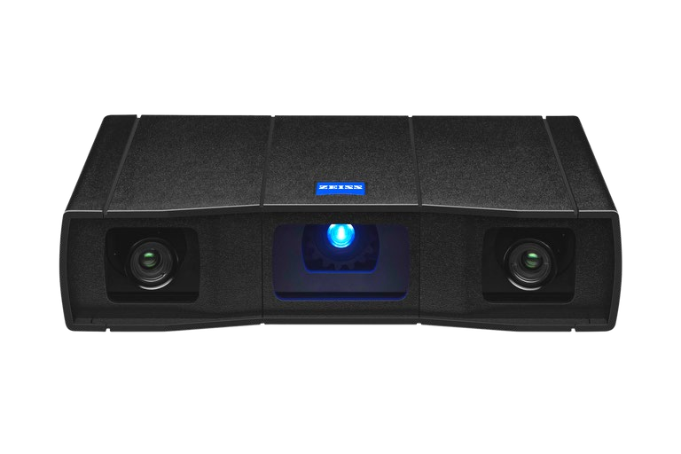
GOM SCAN 1

Slide 4
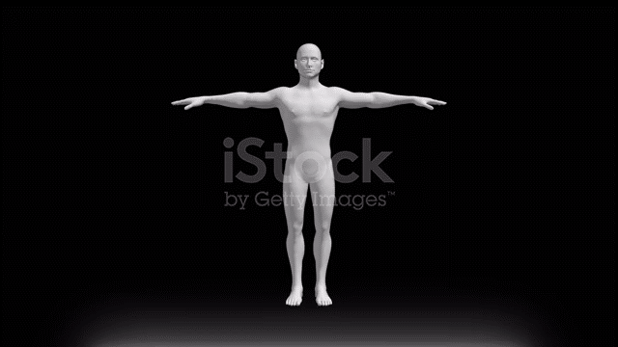

Slide 5
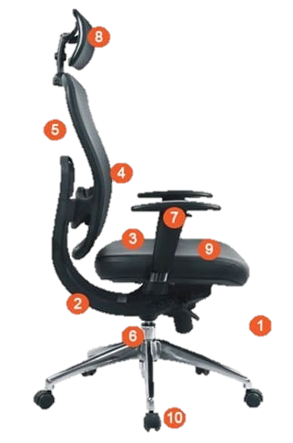








Headrest
Backrest
Lumbar support
Armrests
Backrest recline
Seat tilt
Materials
Seat width and depth
Seat height
Swivel
Wheels

Slide 6

